Slide 1
Noise Pollution

Slide 2
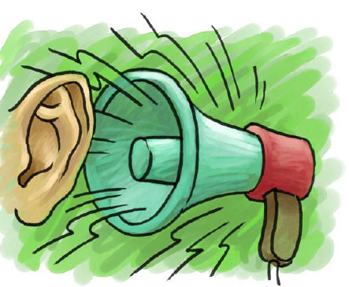

WHAT IS NOISE POLLUTION?
Sound that is unwanted or disrupts one’s quality of life is called as noise. When there is lot of noise in the environment, it is termed as noise pollution.
Sound becomes undesirable when it disturbs the normal activities such as working, sleeping, and during conversations.
It is an underrated environmental problem because of the fact that we can’t see, smell, or taste it.
World Health Organization stated that “Noise must be recognized as a major threat to human well-being”

Slide 3
Noise pollution hazards
65 dBA – noise level for conversation heard at a distance of 1 meter
125 dBA gives sensation of pain in ear
150 dBA might kill a human being
Pathological or psychological disorders
Pathological effects produced by particular noise frequencies causing vibrations or resonance in humans.
High frequencies or ultrasonic sound above normal range can affect semi circular canals of inner ear and make one suffer from nausea and dizziness.

Slide 4
Noise pollution hazards
Very low frequency noise can produce resonance in body organs leading to reduced heartbeats variation in blood pressure and breathing difficulties.
Mid audible band frequencies –resonance in skull and affect the brain and nervous sysstem- impact on thinking and coordination of limbs.
Moderate vibration- pain, numbness and cyanosis of fdingers
Severe vibration results in damage to bones and joints in hands with swelling and stiffness

Slide 5
Noise pollution hazards
Children excessive noise show signs of behavioral disorders later age manifest with destructive nature
Chronic exhaution and consecutive tension in humans
Disturbance in sleep –aged people
Impact on migratory birds

Slide 6
Health Effects
According to the USEPA, there are direct links between noise and health. Also, noise pollution adversely affects the lives of millions of people.
Noise pollution can damage physiological and psychological health.
High blood pressure, stress related illness, sleep disruption, hearing loss, and productivity loss are the problems related to noise pollution.
It can also cause memory loss, severe depression, and panic attacks.

Slide 7
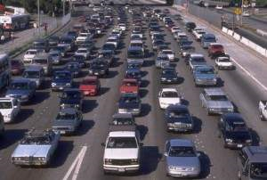
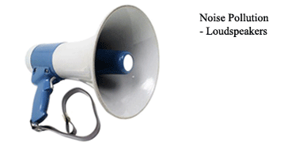
Sources of Noise Pollution
Transportation systems are the main source of noise pollution in urban areas.
Construction of buildings, highways, and streets cause a lot of noise, due to the usage of air compressors, bulldozers, loaders, dump trucks, and pavement breakers.
Industrial noise also adds to the already unfavorable state of noise pollution.
Loud speakers, plumbing, boilers, generators, air conditioners, fans, and vacuum cleaners add to the existing noise pollution.

Slide 8

Solutions for Noise Pollution
Planting bushes and trees in and around sound generating sources is an effective solution for noise pollution.
Regular servicing and tuning of automobiles can effectively reduce the noise pollution.
Buildings can be designed with suitable noise absorbing material for the walls, windows, and ceilings.
Workers should be provided with equipments such as ear plugs and earmuffs for hearing protection.

Slide 9
Solutions for Noise Pollution
Similar to automobiles, lubrication of the machinery and servicing should be done to minimize noise generation.
Soundproof doors and windows can be installed to block unwanted noise from outside.
Regulations should be imposed to restrict the usage of play loudspeakers in crowded areas and public places.
Factories and industries should be located far from the residential areas.

Slide 10
Solutions for Noise Pollution
Community development or urban management should be done with long-term planning, along with an aim to reduce noise pollution.
Social awareness programs should be taken up to educate the public about the causes and effects of noise pollution.

