Slide 1
Noise Pollution
Noise classification

Slide 2
Noise classification
Transport noise
Occupational Noise
Neighbourhood Noise

Slide 3
Transport Noise
Road traffic Noise
Aircraft noise
Rail traffic noise

Slide 4
Road Traffic Noise
Directly proportional to number of vehicles operated on the road
Increase in number of road vehicles and in turn road traffic density
Increase in traffic speed-increase in noise volume.
Modern highways encourage higher speed.
Irritating horns

Slide 5
Road Traffic Noise
Road traffic noise depends on various factors
Vehicles- e.g., heavy diesel engined trucks
Traffic density
Hour of the day
Urban roads: distinct traffic peaksin the morning and evening. (10.00 hours and 18.00 hours)

Slide 6
Aircraft noise
Different from road traffic noise in being intermittent
Peak depends upon number and type of aircraft and operational height.
aeroplane take off and landing

Slide 7
Rail traffic Noise
Comparatively less serious
Lower frequency than that of street vehicles
Buildings located near railway tracks exposed to noise menace
Introduction of diesel and all electric locomotives has reduced rail traffic noise

Slide 8
Occupational Noise
Mainly produced by industrial machines and processes and affects millions of people. Industrial workers exposed 8 hours a day and 6 days a week.
Also includes noise from domestic gadgets, e.g. washing machines, vacuum cleaners etc.
Noisy industrial processes and conditions cause hearing loss to the workers involved.
Noise reduction is essential so that they do not suffer from progressive hearing damage, their efficiency may be enhanced and accidents may be reduced. This would ensure improvement in working conditions.

Slide 9
Occupational Noise
Industrial source | Noise level dB
Steel plate riveting | 130
Oxygen torch | 126
Boiler maker’s shop | 120
Textile loom | 112
Circular saw farm tractor | 110
Newspaper press | 103
Bench lathe | 101
Milling machine | 95
High speed drill | 85

Slide 10
Neighbourhood Noise
Variety of sources of noise that disturb and annoy the general public by interfering with comfort and welfare
Loud T.V., radio set, loudspeakers in public functions, disco music etc.

Slide 11
L10, L50 and L90
L10 is the level exceeded for 10% of the time. For 10% of the time, the sound or noise has a sound pressure level above L10. For the rest of the time, the sound or noise has a sound pressure level at or below L10. These higher sound pressure levels are probably due to sporadic or intermittent events.
L50 is the level exceeded for 50% of the time. It is statistically the mid-point of the noise readings. It represents the median of the fluctuating noise levels.
L90 is the level exceeded for 90% of the time. For 90% of the time, the noise level is above this level. It is generally considered to be representing the background or ambient level of a noise environment.
For a varying sound, L10 is greater than L50 which in turn is greater than L90. The following graph illustrates L10, L50 and L90.

Slide 12
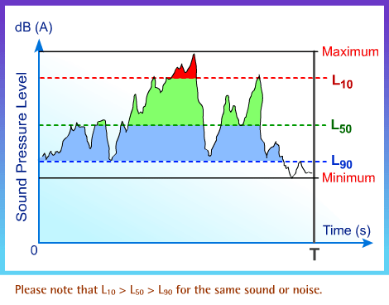

Slide 13
Use of L10 to Describe Traffic Noise
The early definitive work on traffic noise was done in England around the 1960's. Extensive research carried out in England showed that the descriptor L10(18 hour), the noise level exceeded for 10% of the time between 6 a.m. and 12 midnight, correlated well with the community response. L10(18 hour) of 68 dB(A) at 1m outside facade of dwellings was adopted in the UK as the eligibility criterion for acoustic insulation.
Traffic noise planning standard in Hong Kong is L10(1 hour) of 70 dB(A) measured over the peak hour of traffic. The standard was formulated after review of similar standards in other developed countries. Field measurement in Hong Kong also revealed that L10(1 hour) of 70 dB(A) over the peak hour is roughly the same as L10(18 hour) of 68 dB(A), for the kind of normal traffic flow situations encountered in Hong Kong.
The traffic noise planning standard, which is L10(1 hour) of 70 dB(A), means that when this limit is just met, traffic noise will exceed 70 dB(A) for 10% of an hour. For the remaining time, the traffic noise will be less than 70 dB(A).

Slide 14
Equivalent Continuous Sound Pressure Level, Leq
This is a widely used noise descriptor that is commonly adopted in many developed countries. It is the constant noise level which, under a given situation and time period, contains the same acoustic energy as the actual time-varying noise level. As Leq measures the energy content of a noise over a period of time, noise with different characteristics, such as fluctuating (e.g. from traffic) or impulsive noise (e.g. from hammering) as described in the next section, can give the same Leq Level.
When noise or sound is measured in dB(A), it is customary to denote the equivalent continuous sound pressure level as LAeq.

Slide 15
Leq for Continuous, Fluctuating and Impulsive Noises
Environmental noise is often non-steady. But there are some exceptions. Noise from air-conditioners is relatively steady. A fluctuating noise has its magnitude varying quite considerably over time. Examples are road traffic noise, rock music and noise from helicopter flyover.
For an impulsive noise, the level rises sharply and then falls rapidly. Examples include hammering, shooting and firecracker noise.
Let us look at the equivalent continuous sound pressure levels of different types of noises as below. Please note that although the types of noise can be different, traffic noise and hammering may produce the same level of LAeq if the sound energies produced are the same at the receiver.

